Slide 1

Classroom Management System
Tasnim Ferdous 180041108
Sidratul Muntaha 180041118
Farhan Ishmam 180041120

Slide 2
Introduction
Management Information System (MIS)
Organizes Classroom Usage
Eliminates conflict
Reduces time required for searching manually
Keeps records of past and future usage of classrooms
CMS
02

Slide 3
User Requirements
Highest Priority:
Booking classrooms without booking conflicts
Finding and booking a classroom based on a set of requirements
High Priority:
Relaying information about classroom schedule to users
Allow certain users to access and modify records
Requirements based on the data collected from the targeted users, sorted according to priorities:
03

Slide 4
User Requirements
Medium Priority:
Web-based access from any platform
Simple, easy and intuitive user interface
Requirements based on the data collected from the targeted users, sorted according to priorities:
03

Slide 5
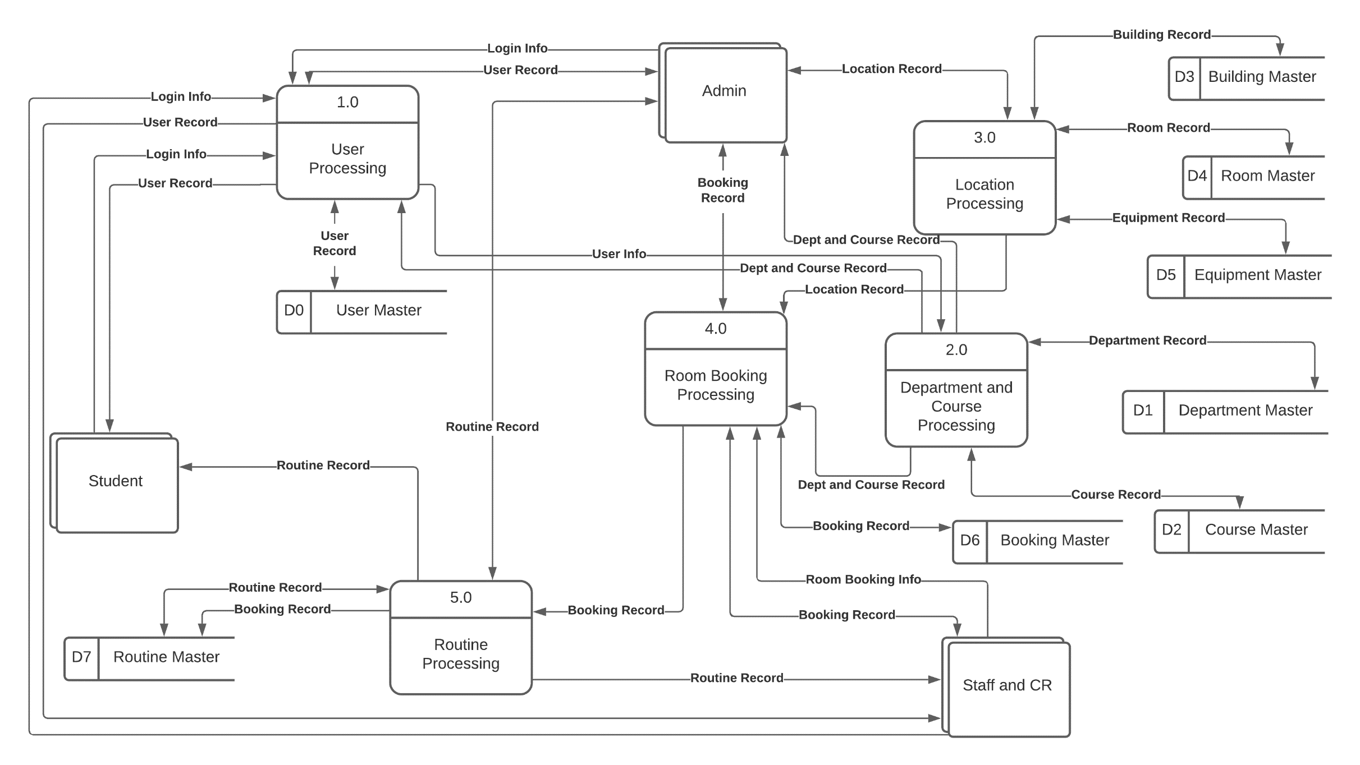
Diagram 0
04

Slide 6
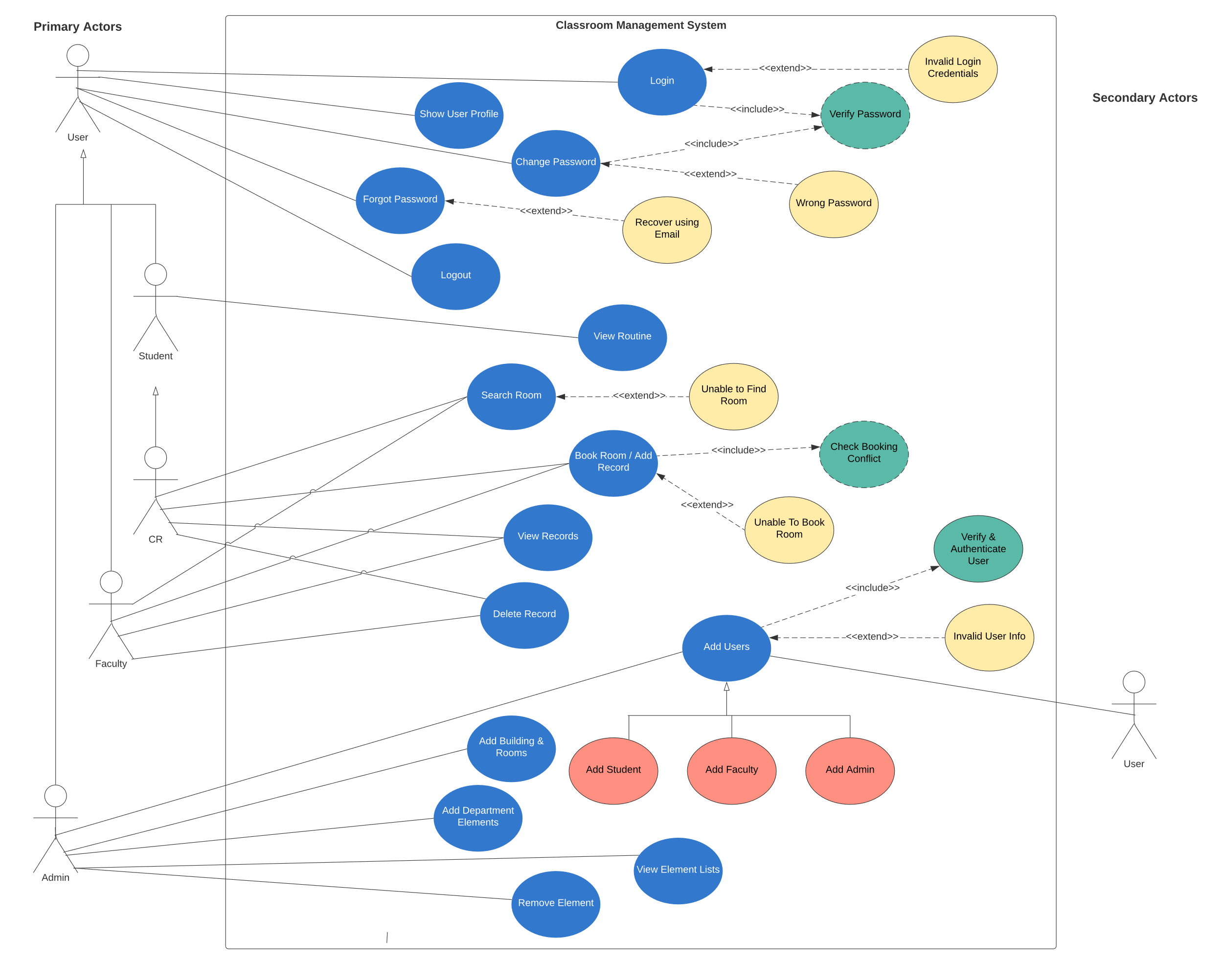
Use Case Diagram
05

Slide 7
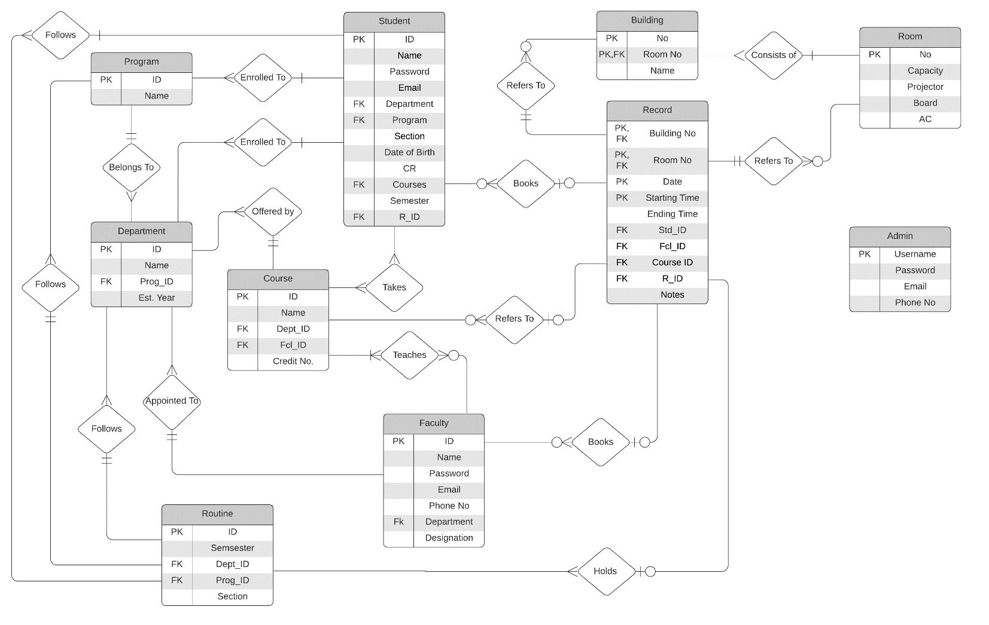
ER-Diagram
06

Slide 8
Features
Search Rooms based on Requirements
Booking Rooms without Booking Conflicts
Manage User Records
Display Routine for Students
Access User Profile
User Authentication and Password Recovery.
Role based User Access.
Administrative Features (adding/removing elements).
Implemented
07

Slide 9
Features
Display Allocated Classroom for Students
Mobile App
User Notification System on Mobile App
Under
Implementation
Faculty Routine
Making Recurring Bookings
Course Entity, Validation, Add and Remove
Integrating Attendance and Grading System
Enrolling and unrolling to courses
Not
Implemented
08

Slide 10
THANK YOU

